Slide 1
Additional Aqueous Equilibria
Copies of these slides also under content
(OpenStax 14 & 15, Gilbert Chapter 16)
Answers to questions will be presented in a separate file after the deadline.

Slide 2
Chapter Outline
16.1 Ocean Acidification: Equilibrium Under Stress
16.2 The Common-Ion Effect
16.3 pH Buffers
16.4 Indicators and Acid-Base Titrations
16.5 Lewis Acids and Bases
16.6 Formation of Complex Ions
16.7 Hydrated Metal Ions as Acids
16.8 Solubility Equilibria

Slide 3
Video of following slides:
Common ion and Henderson-Hasselbalch
Common ion slide to buffers.

Slide 4
Common-Ion Effect
Common-Ion Effect: Shift in position of an equilibrium caused by the addition of an ion taking part in the reaction
Example:
H₂CO₃ (aq) ⇌ H⁺(aq) + HCO₃⁻(aq)
What happens if NaHCO₃ is added?
Common-ion!!
Common-ion effect is essentially an application of Le Châtelier’s Principle:
NaHCO₃(s) → Na⁺(aq) + HCO₃⁻(aq)
The presence of additional HCO₃⁻(aq) would shift carbonic acid equilibrium to the left, decreasing ionization

Slide 5
Henderson-Hasselbalch Equation Review
Weak acid equilibrium:
HA(aq) + H₂O(ℓ) ⇌ H₃O⁺(aq) + A⁻(aq)
Take the -log of both sides:
Substitute pX quantities:
Rearrange:
Use property of logs:
Henderson-Hasselbalch Equation

Slide 6
Practice: Common-Ion Effect
Calculate the pH of a solution containing 0.22 M acetic acid and 0.13 M sodium acetate. (K_{a} of acetic acid = 1.8×10⁻⁵)
CH₃COOH(aq) + H₂O(ℓ) ⇌ CH₃COO⁻(aq) + H₃O⁺(aq)
For a system involving both an acid and salt of its conjugate base:
(Assuming complete dissociation of the salt)
Substitute and solve:

Slide 7
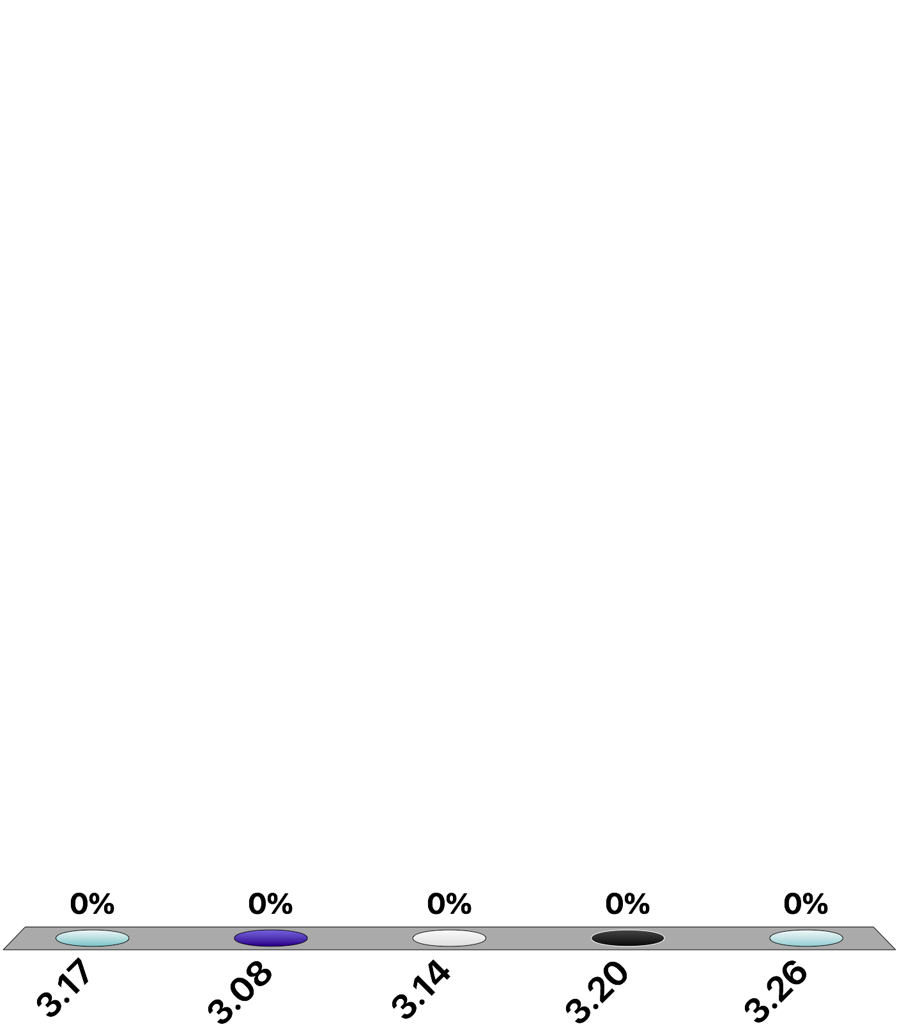
What is the pH of a solution prepared by mixing 450 mL of 1.2 M HF with 590 mL of 0.98 M NaF? The K_{a} of hydrofluoric acid is 6.8×10⁻⁴. Assume volumes are additive (i.e. use the new molarities).
Your Turn TopHat : Common-ion Effect
3.17
3.08
3.14
3.20
3.26
Notes:
Answers in separate file.

Slide 8
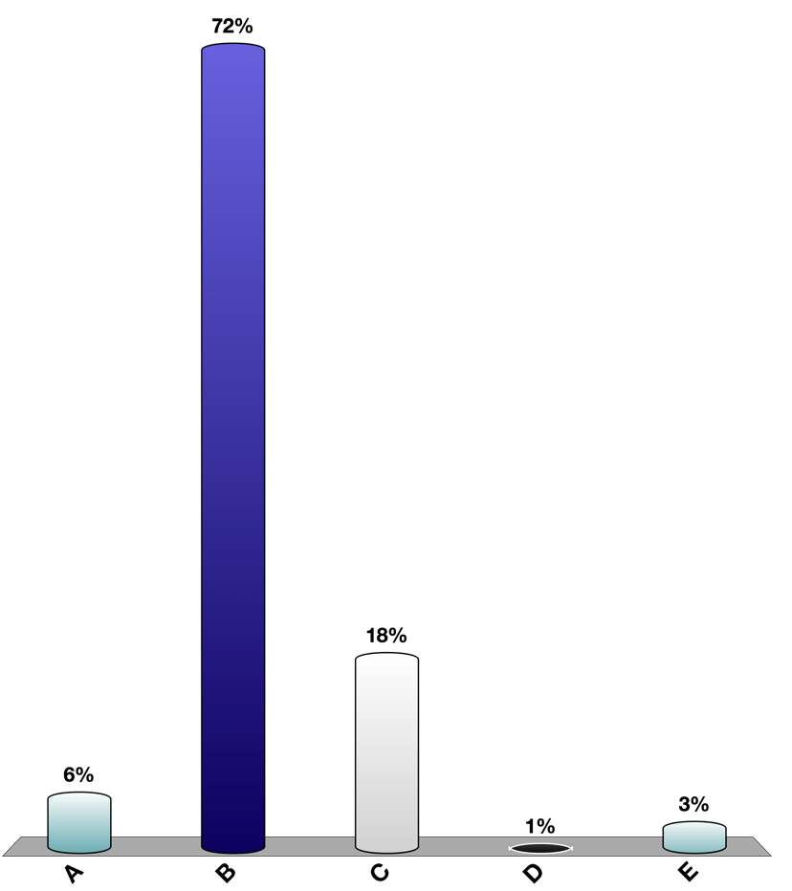
What is the pH of a solution prepared by mixing 450 mL of 1.2 M HF with 590 mL of 0.98 M NaF? The K_{a} of hydrofluoric acid is 6.8×10⁻⁴. Assume volumes are additive.
Practice solution: Common-ion Effect
HF(aq) + H₂O(ℓ) ⇌ F⁻(aq) + H₃O⁺
For a system involving both an acid and a salt:
Need to calculate new acid/base molarity:
Substitute and solve:
Assume complete dissociation:

Slide 9
Video of following slides:
Buffers and pH Indicators
There is a portion of this video that is blank and restarts at about 15 minutes to continure with pH indicators.

Slide 10
pH Buffers
Buffer: Solution that resists changes in pH when acids or bases are added to it
Typically contains a weak acid or base and its conjugate partner (HA and A⁻)
HA(aq) + H₂O(ℓ) ⇌ H₃O⁺(aq) + A⁻(aq)
The weak acid (HA) reacts with added base
HA(aq) + OH⁻(aq) ⇌ H₂O(ℓ) + A⁻(aq)
The weak base (A⁻) reacts with added acid
A⁻(aq) + H₃O⁺(aq) ⇌ HA(aq) + H₂O(ℓ)
Notes:
2
2

Slide 11
Natural Buffer Examples
Presence of carbonate in rivers, lakes protects natural waters from acid rain
H₂CO₃(aq) ⇌ HCO₃⁻(aq) + H⁺(aq)
Physiological pH of blood (~7.4)—must be maintained in narrow range for optimal health
CO₂(aq) + H₂O(ℓ) ⇌ H₂CO₃(aq) ⇌ HCO₃⁻(aq) + H⁺(aq)
Acids present in acid rain (HNO_{x}, H₂SO_{x}) are neutralized by bicarbonate (HCO₃⁻)
Too much CO₂(aq)…reaction shifts right…pH decreases…acidosis
Decrease in blood CO₂ (i.e., hyperventilation)…reaction shifts left…pH increases…alkalosis.

Slide 12
Buffer Range and Capacity
Buffer Range:
pH range within which a given buffer can provide pH protection
Buffer range = pK_{a} of weak acid ± 1
Buffer Capacity:
Quantity of acid/base that a buffer can neutralize while maintaining pH within desired range
Proportional to component concentrations

Slide 13
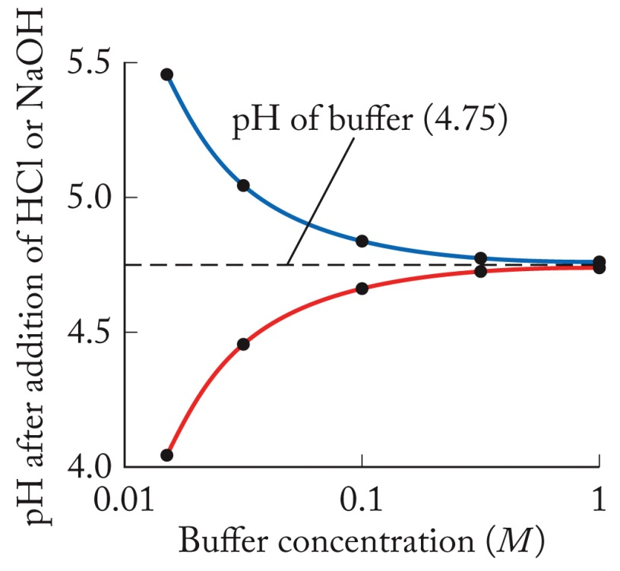
pH Change of Buffer v. Buffer Conc.
Addition of strong base
The greater the initial concentrations of HA and A⁻, the less the change in pH as acid or base is added to the buffer solution.
Addition of strong acid
More Moles of buffer means acid or base has less affect

Slide 14
Practice: Preparation of Buffer
Determine the number of moles of sodium acetate that must be added to 250.0 mL of 0.16 M acetic acid to prepare a pH 4.70 buffer (K_{a} = 1.76 × 10⁻⁵).
CH₃COOH(aq) + H₂O(ℓ) ⇌ CH₃COO⁻(aq) + H₃O⁺(aq)
Henderson-Hasselbalch Equation:
Solve for [CH₃COO⁻]:

Slide 15
Practice: Preparation of Buffer
Determine the number of moles of sodium acetate that must be added to 250.0 mL of 0.16 M acetic acid to prepare a pH 4.70 buffer (K_{a} = 1.76 × 10⁻⁵).
CH₃COOH(aq) + H₂O(ℓ) ⇌ CH₃COO⁻(aq) + H₃O⁺
Plug-in quantities:
Use stoichiometry to solve for moles:

Slide 16
pH Indicators
pH Indicator:
Water-soluble, weak organic acid that changes color as pH changes
Example, phenol red (pK_{a} = 8.6):
HIn(aq) + H₂O(ℓ) ⇌ H₃O⁺(aq) + In⁻(aq)
(yellow) (red)
(this is a generalized equation)
(pH range of color change)

Slide 17
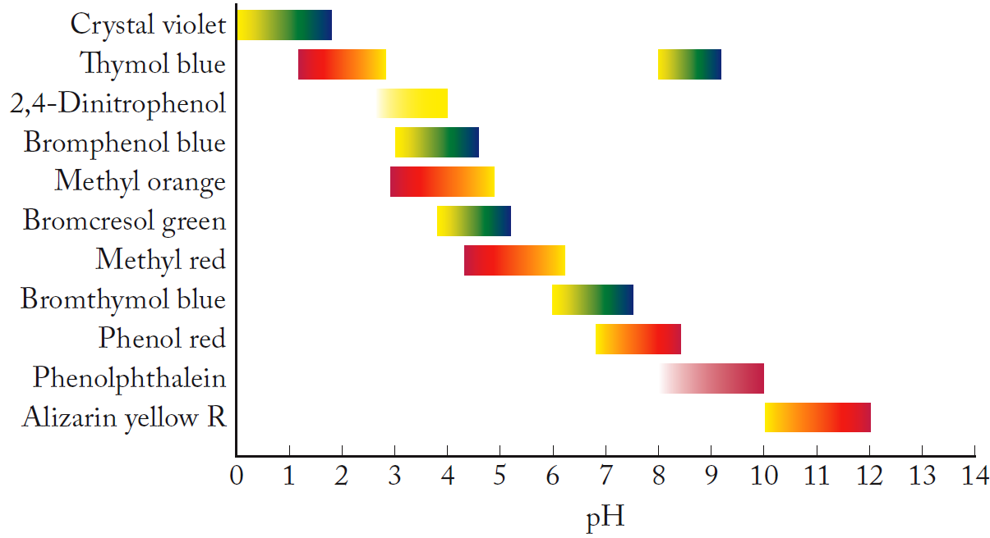
pH Indicators

Slide 18
pH Titrations
Steps in Titration:
Accurately transfer known volume of sample to flask or beaker
Add a few drops of indicator or insert probe of pH meter
Fill buret with solution of known concentration (titrant) to react with solute sample (analyte)
Slowly add titrant until reaction is complete (equivalence point or end point)

Slide 19
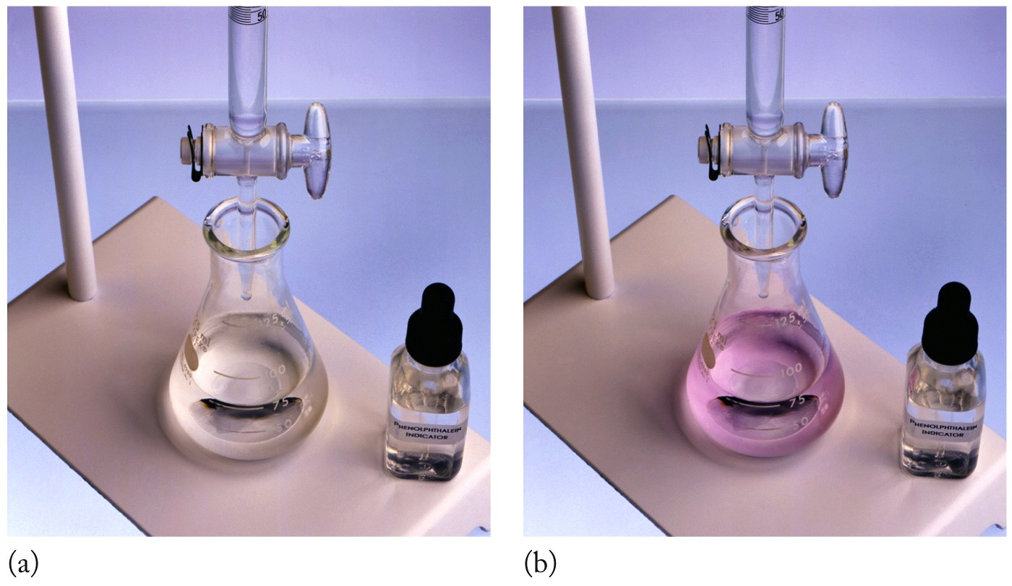
Example: Titrations
H₂SO₄ + 2NaOH → Na₂SO₄ + 2H₂O
NaOH
(titrant)
H₂SO₄
(unknown)
End Point
(Chapter 8)

Slide 20
A 500 mg dietary supplement of l-lysine (an amino acid, 146.2 g/mol) required 68.4 mL of 0.100 M NaOH to reach the end point. How many hydrogen ions were removed for each l-lysine molecule in this titration?
Your Turn TopHat: Titrations Clicker:
1
2
3
0.5
2.5
Notes:
Answer in separate file

Slide 21
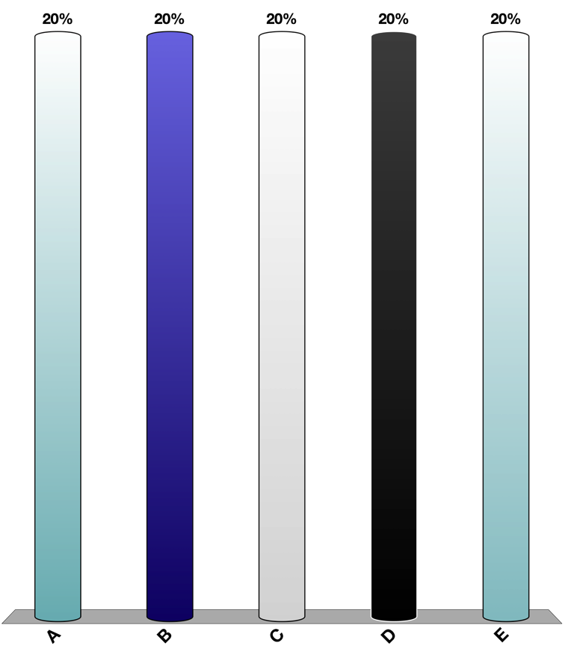
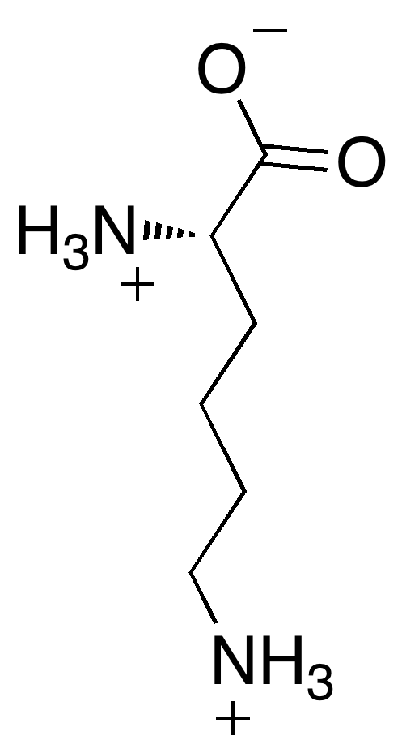
A 500 mg dietary supplement of l-lysine (an amino acid, 146.2 g/mol) required 68.4 mL of 0.100 M NaOH to reach the end point. How many hydrogen ions were removed for each l-lysine molecule in this titration?
Practice Titrations solution:
H⁺ + NaOH → Na⁺ + H₂O
1 mol of acid (H⁺) will react with 1 mol of base (OH⁻)
need to determine how many hydrogens removed per lysine molecule
weak acid dissociation
lysine ⇌ xH⁺ + lysine^{x-}

Slide 22
Video of following slides:
Titration Overview

Slide 23
Review: Titrations
Titration: Analytical method to determine the concentration of a solute in a sample by reacting it with a standard solution
Standard Solution: A solution of known concentration (also called the titrant)
Equivalence Point: When moles of titrant is stoichiometrically equivalent to moles of the substance being analyzed
End Point: When the indicator changes color
(Chapter 8)

Slide 24
Key Steps to Solving ANY Titration Problem
Write a chemical equation that appropriately describes the chemistry occurring in the flask.
Determine where the titration is at: a. beginning (no titrant added); b. somewhere in the middle; c. equivalence point; or d. past equivalence point.
Based on these locations do one of the following to calculate pH:
Solve simple equilibrium problem (ICE table)
Use Henderson-Hasselbalch equation
Write new equilibrium going in opposite direction, solve simple equilibrium problem (ICE table).
Use excess acid/base concentration

Slide 25
Review: Acid-Base Titrations
What is the concentration of sulfuric acid if 15.00 mL of it reacts with 18.45 mL of a 0.0973 M NaOH solution?
H₂SO₄ + 2NaOH → Na₂SO₄ + 2H₂O
(Chapter 8)

Slide 26
pH Titrations
Notice! NaCl is a neutral salt; pH 7.0
Strong Acid–Strong Base:
HCl(aq) + NaOH(aq) → H₂O(ℓ) + NaCl(aq)
Because both completely ionize, straight-forward stoichiometry applies
At equivalence point:
moles H⁺ = moles OH⁻
M_{HCl}V_{HCl} = M_{NaOH}V_{NaOH}

Slide 27
Review: Acid-Base Titrations
If 30.34 mL of a 0.135 M solution of hydrochloric acid (HCl) were required to neutralize 25.00 mL of a sodium hydroxide (NaOH) solution, what is the molarity of the sodium hydroxide solution?
NaOH + HCl → NaCl + H₂O
(Chapter 8)

Slide 28
pH Titrations
Strong Acid–Weak Base:
HCl(aq) + NH₃(aq) ⇌ H₂O(ℓ) + NH₄Cl(aq)
Overall reaction
Ammonia is your “sample”; hydrochloric acid is your “titrant”.
Weak base equilibrium
NH₃(aq) + H₂O(ℓ) ⇌ NH₄⁺(aq) + OH⁻(aq)
Think about adding HCl(aq) as a way of “neutralizing” the generated OH⁻
OH⁻(aq) + HCl(aq) ⇌ H₂O(ℓ) + Cl⁻(aq)
This is another Le Chatelier’s Principle situation:
NH₃(aq) + H₂O(ℓ) ⇌ NH₄⁺(aq) + OH⁻(aq)
constantly removing OH⁻
= driving reaction to right, increasing [NH₄⁺]
Using:
Where:
Can calculate the pH at any point in the titration!
[NH₃] = conjugate base
[NH₄⁺] = weak acid
(at equilibrium)
Notes:
Hidden because too redundant and I don’t hink the removing OH helps understanding.

Slide 29
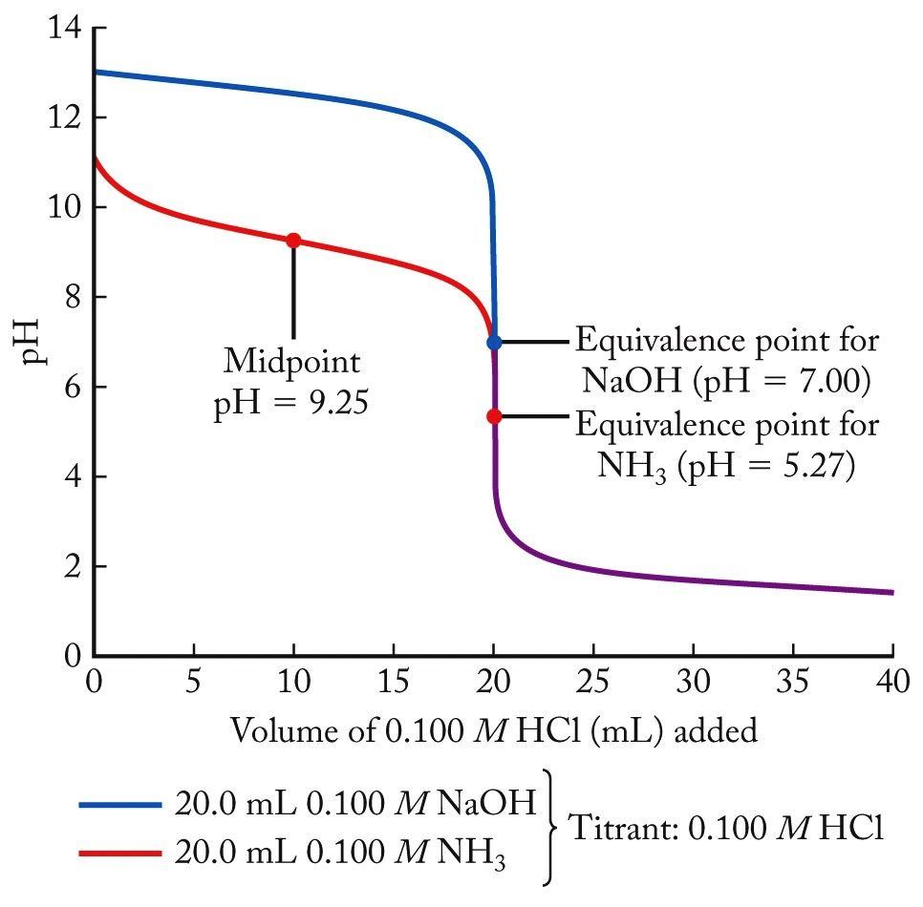
Titration Curves: NH₃ and NaOH
At start, no HCl added, simply calculate at equilibrium, [NH₃], [NH₄⁺], [H⁺]
Notice: we are dealing with a weak base, make sure to convert a K_{b} to a K_{a} value for use here!
pH = pK_{a}
[NH₄⁺] = max
(100% ionization)
Can calculate pH at any point, just need to calculate [NH₃], [NH₄⁺] (Remember to account for change in total volume!)
[NH₃] = [NH₄⁺]
(50% complete ionization)
mol NH₃ initial = mol HCl added
At equivalence point, all [NH₄⁺], write new acid equilibrium, calculate pH
Beyond the equivalence point, the change in pH is associated with additional [H⁺] from excess HCl

Slide 30
pH Titrations
Weak Acid–Strong Base:
CH₃COOH(aq) + NaOH(aq) ⇌ H₂O(ℓ) + CH₃COONa(aq)
Overall reaction
Acetic acid is your “sample”; sodium hydroxide is your “titrant”.
Weak acid equilibrium
CH₃COOH(aq) + H₂O(ℓ) ⇌ CH₃COO⁻(aq) + H₃O⁺(aq)
Think about adding NaOH(aq) as a way of “neutralizing” the generated H⁺
H₃O⁺(aq) + NaOH(aq) ⇌ 2H₂O(ℓ) + Na⁺(aq)
This is another Le Chatelier’s Principle situation:
CH₃COOH(aq) + H₂O(ℓ) ⇌ CH₃COO⁻(aq) + H₃O⁺(aq)
constantly removing H₃O⁺
= driving reaction to right, increasing [CH₃COO⁻]
Can calculate the pH at any point in the titration!
Using:
Where:
[CH₃COO⁻] = conjugate base
[CH₃COOH] = weak acid
(at equilibrium)

Slide 31
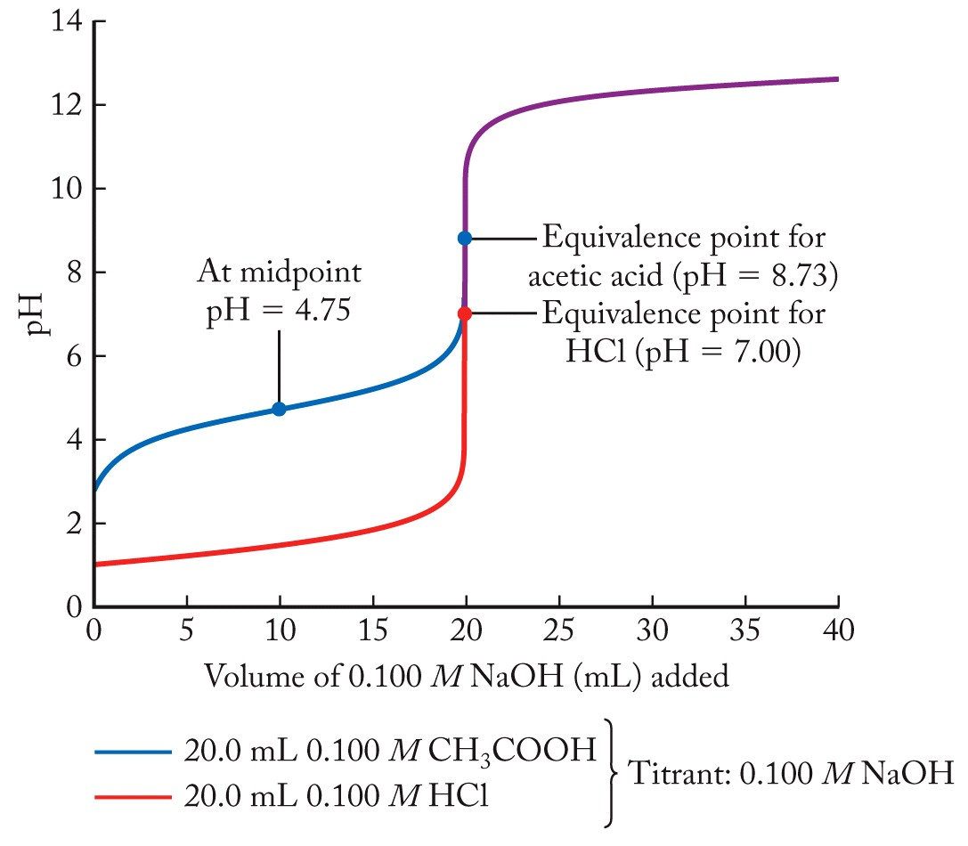
Titration Curves: CH₃COOH and HCl
Beyond the equivalence point, the change in pH is associated with additional [OH⁻] from excess NaOH
[CH₃COOH] = [CH₃COO⁻]
(50% complete ionization)
[CH₃COO⁻] = max (100% ionization)
mol CH₃COOH initial = mol NaOH added
pH = pK_{a}
At equivalence point, all [CH₃COO⁻],
write new base equilibrium, calculate pH
At start, no NaOH added, simply calculate at equilibrium, [CH₃COOH], [CH₃COO⁻], [H⁺]
Can calculate pH at any point, just need to calculate [CH₃COOH], [CH₃COO⁻] (Remember to account for change in total volume!)

Slide 32
Video of following slides:
Polyprotic Acids
The slides in the video do not exactly match the ones below but cover the same concepts.

Slide 33
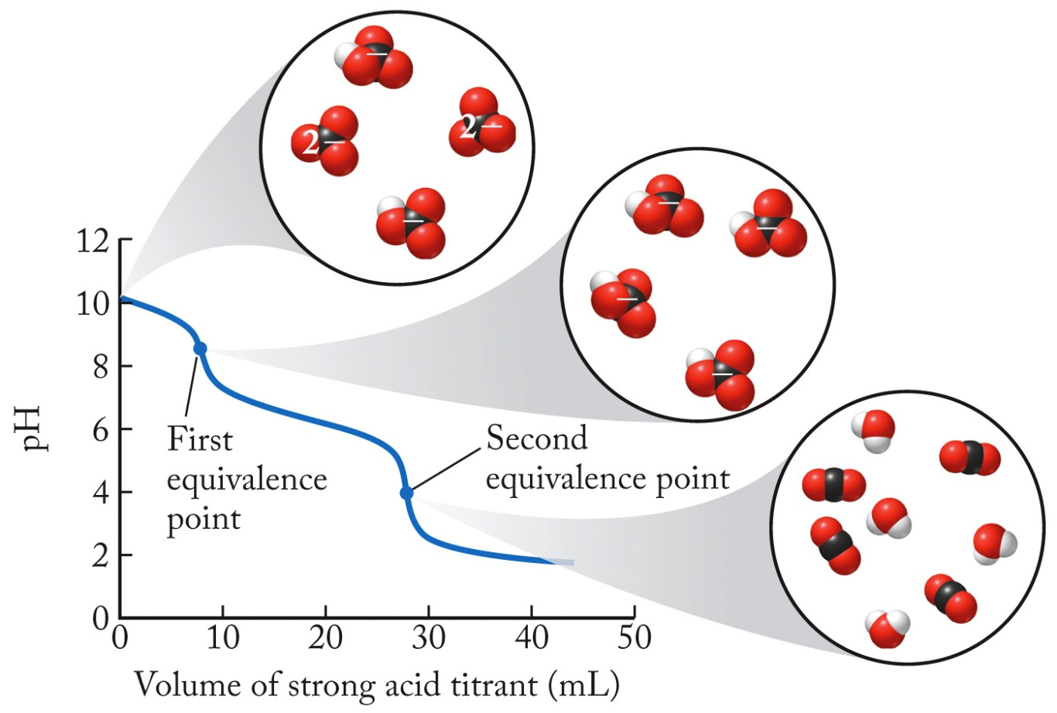
Polyprotic or Polybasic Acids/Bases
(1) CO₃²⁻(aq) + H⁺(aq) ⇌ HCO₃⁻(aq)
(2) HCO₃⁻(aq) + H⁺(aq) ⇌ H₂CO₃(aq)
Multiple equivalence points!
First eq. pt.
pH = 8.5
Second eq. pt.
pH = 4.0

Slide 34
Practice: pH Titration
A 40.0 mL solution of 0.100 M sodium hypochlorite NaClO(s) is titrated with a 0.100 M HCl solution. Select an appropriate indicator to detect the equivalence point in this titration.
Need to determine pH at equivalence point!
conjugate base of a weak acid
NaClO(s) ⇌ Na⁺(aq) + ClO⁻(aq)
weak base equilibrium
ClO⁻(aq) + H₂O(ℓ) ⇌ HClO(aq) + OH⁻(aq)
Think about adding HCl(aq) as a way of “neutralizing” the generated OH⁻
at equivalence point: [HClO] = max (100% conversion)
mol ClO⁻ initial = mol HCl added
Can use stoichiometry to calculate the moles at equivalence point:
Can use stoichiometry to calculate the volume of 0.1 M HCl added:

Slide 35
Practice: pH Titration
Can use stoichiometry to calculate the moles of ClO⁻ at equivalence point:
Can use stoichiometry to calculate the volume of 0.1 M HCl added:
Can now calculate molarity of [HClO] at equivalence point:
Hypochlorous acid is a weak acid, can write an acid dissociation equation that is operative:
HClO(aq) + H₂O(ℓ) ⇌ ClO⁻(aq) + H₃O⁺(aq)
And an equilibrium expression, K_{a}
K_{a} is small, assume: x << 0.05 M
Substitute for equilibrium quantities:

Slide 36
Practice: pH Titration
Hypochlorous acid is a weak acid, can write an acid dissociation equation that is operative:
HClO(aq) + H₂O(ℓ) ⇌ ClO⁻(aq) + H₃O⁺(aq)
And an equilibrium expression, K_{a}
Assume: x << 0.05 M
Substitute for equilibrium quantities:
Now, (finally!), can calculate pH at equivalence point:
Makes sense, we have the conjugate acid dissociating here.
Problem asks…what indicator would be appropriate?
Any one that changes color around our equivalence point

Slide 37
pH Indicators
One of these.

Slide 38
A 200.0 mL solution of 0.40 M ammonium chloride was titrated with 0.80 M sodium hydroxide. What was the pH of the solution after 50.0 mL of the NaOH solution were added? The K_{b} of ammonia is 1.76×10⁻⁵. What do we have to pick out to identify this problem?
Your turn TopHat: Titration Calculations
9.25
4.75
11.22
5.02
8.98
Notes:
Answers in a different file

Slide 39
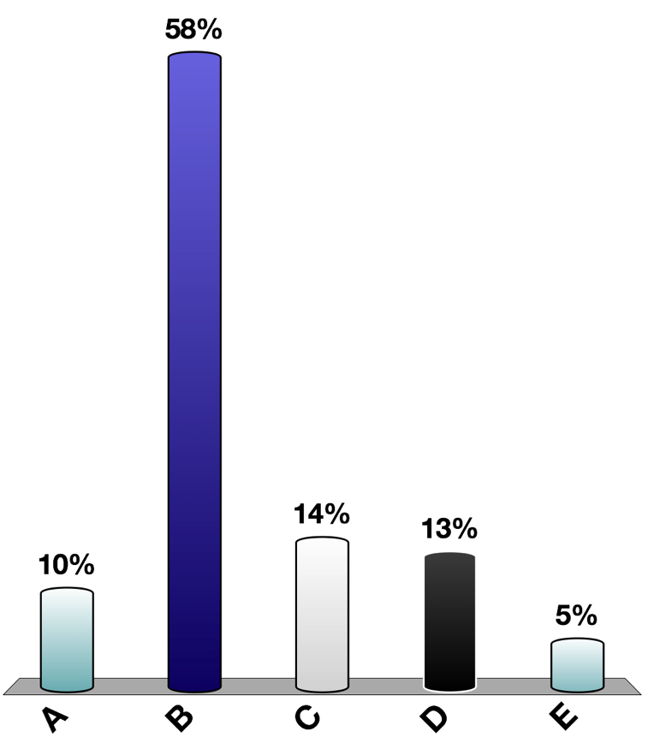
A 200.0 mL solution of 0.40 M ammonium chloride was titrated with 0.80 M sodium hydroxide. What was the pH of the solution after 50.0 mL of the NaOH solution were added? The K_{b} of ammonia is 1.76×10⁻⁵.
Your turn TopHat: Titration Calculations
NH₄⁺(aq) + H₂O(ℓ) ⇌ NH₃(aq) + H₃O⁺(aq)
Can use to calculate pH at any point of titration except start and equivalence point
Need to calculate molar amounts of acid/base:

Slide 40
A 200.0 mL solution of 0.40 M ammonium chloride was titrated with 0.80 M sodium hydroxide. What was the pH of the solution after 50.0 mL of the NaOH solution were added? The K_{b} of ammonia is 1.76×10⁻⁵.
Your turn TopHat: Titration Calculations
NH₄⁺(aq) + OH– (aq) ⇌ NH₃(aq) + H₂O(l)
Start 0.08 mol
Added + 0.04 mol
Change –0.04mol – 0.04 mol +0.04
At this point : 0.04 mol 0.04 mol
At the midpoint!
Calculate pH:

Slide 41
Your Turn TopHat: Calculate the K for reaction of weak acid + strong base
Acetic acid is your “sample”; sodium hydroxide is your “titrant”.
CH₃COOH(aq) + H₂O(ℓ) ⇌ CH₃COO–(aq) + H₃O⁺(aq) K_{a} = 1.76 x 10^{–5}
H₃O⁺(aq) + OH–(aq) ⇌ 2H₂O(ℓ) (aq) K = ?
Weak Acid–Strong Base:
CH₃COOH(aq) + OH– (aq) ⇌ H₂O(ℓ) + CH₃COO– (aq)
What is the K for the overall reaction?
Overall reaction
Notes:
Answer in differet file

Slide 42
Clicker next slide: Calculate the K for reaction of weak acid strong base – goes to completion.
Acetic acid is your “sample”; sodium hydroxide is your “titrant”.
CH₃COOH(aq) + H₂O(ℓ) ⇌ CH₃COO⁻(aq) + H₃O⁺(aq) K_{a} = 1.76 x 10^{–5}
H₃O⁺(aq) + NaOH(aq) ⇌ 2H₂O(ℓ) + Na⁺(aq) K₂ = ? = 1/K_{w}
Weak Acid–Strong Base:
CH₃COOH(aq) + NaOH(aq) ⇌ H₂O(ℓ) + CH₃COONa(aq)
What is the K for the overall reaction?
K_{strong} = K_{a} x K₂ = K_{a} x 1/K_{w} = (1.76x10^{–5})/1x10^{–14}
^{K}_{strong} = 1,760,000,000 = 1.76 x 10⁹ very large!!!
Overall reaction

Slide 43
Glycolic acid, which is a monoprotic acid and a constituent in sugarcane, has a pK_{a} of 3.9. A 25.0 mL solution of glycolic acid is titrated to the equivalence point with 35.8 mL of 0.020 M sodium hydroxide solution. What is the pH of the resulting solution at the equivalence point?
Your Turn TopHat: Titrations
4.12
9.88
6.01
7.99
Insufficient information provided
Notes:
Answer in different file

Slide 44
Glycolic acid, which is a monoprotic acid and a constituent in sugarcane, has a pK_{a} of 3.9. A 25.0 mL solution of glycolic acid is titrated to the equivalence point with 35.8 mL of 0.020 M sodium hydroxide solution. What is the pH of the resulting solution at the equivalence point?
Your Turn TopHat: Titrations
glycolic acid(aq) + H₂O(ℓ) ⇌ glycolate⁻(aq) + H₃O⁺(aq)
at equivalence point, all of the acid has been converted to product
mol glycolate⁻ = mol NaOH added
Can use stoichiometry to calculate the moles of glycolate⁻ at equivalence point:
In order to calculate pH here, need concentration of glycolate⁻

Slide 45
Your Turn TopHat: Titrations
Can use stoichiometry to calculate the moles of glycolate⁻ at equivalence point:
In order to calculate pH here, need concentration of glycolate⁻
Also: at equivalence point, need to write a new acid-base equation:
glycolate⁻(aq) + H₂O(ℓ) ⇌ glycolic acid(aq) + OH⁻(aq)
And an equilibrium expression
Assume: x << 0.01178 M
Given pK_{a}, need K_{b}
Can calculate pH via pOH
Substitute for equilibrium quantities:

Slide 46
Chapter Outline
16.1 Ocean Acidification: Equilibrium Under Stress
16.2 The Common-Ion Effect
16.3 pH Buffers
16.4 Indicators and Acid-Base Titrations
16.5 Lewis Acids and Bases
16.6 Formation of Complex Ions
16.7 Hydrated Metal Ions as Acids
16.8 Solubility Equilibria

Slide 47
Video of following slides:
Lewis Acids and Bases Acids

Slide 48
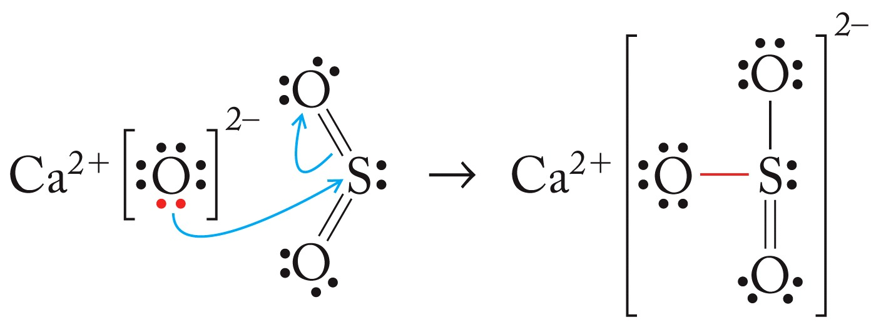
Lewis Acids and Bases
Lewis Base: example: OH–
Substance that donates a lone pair of electrons
Lewis Acid: example: H⁺
Substance that accepts a lone pair of electrons
CaO + SO₂ → CaSO₃
Base donates electron-pair to acid
Acid accepts
electron-pair from base

Slide 49
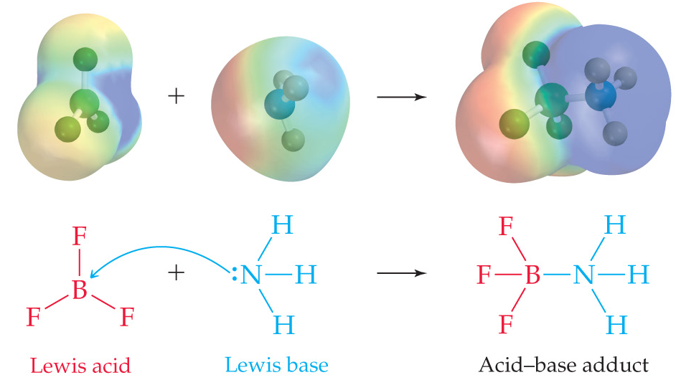
Lewis Acids and Bases
Blue = electron poor
Red = electron rich
Geometry about boron changes from trigonal planar to tetrahedral.
Acid-base behavior like this is an important tenant of many organic reactions
trigonal planar
trigonal pyramid
empty sp³-orbital
lone-pair in sp³-orbital
new sigma bond (sp³-sp³)

Slide 50
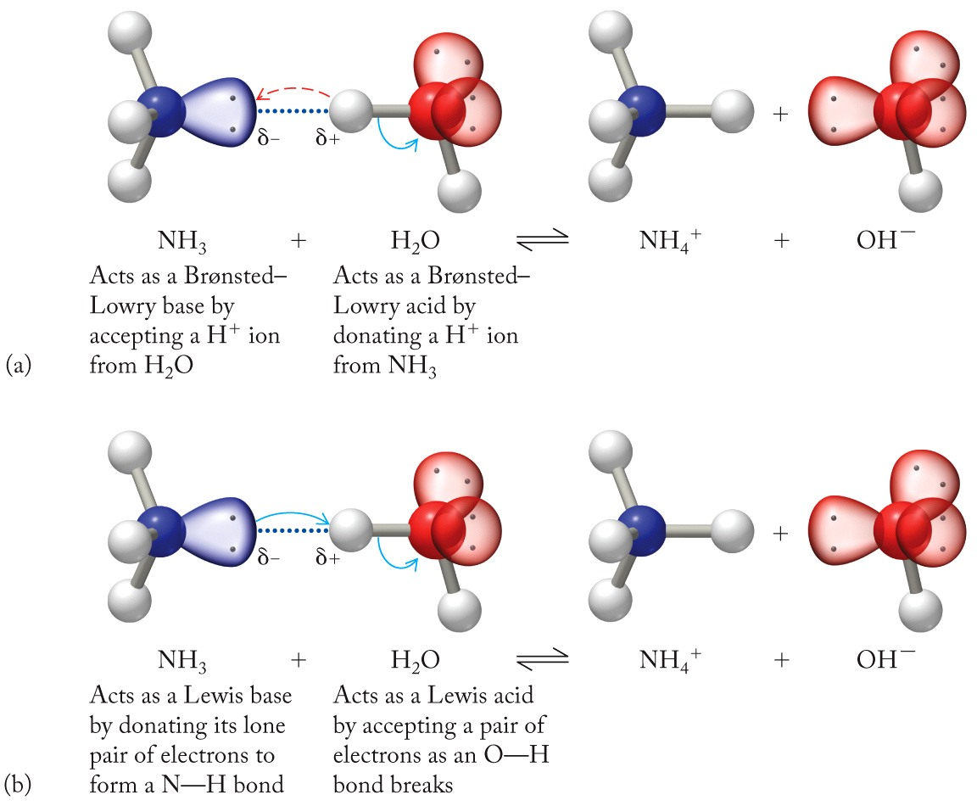
Lewis Acids and Bases
Acid-base reaction:
NH₃ + H₂O ⇌ NH₄⁺ + OH⁻
Brønsted-Lowry model:
Brønsted-Lowry base
(proton acceptor)
Brønsted-Lowry acid
(proton donor)
Lewis model:
Notice: acids & bases can often fit both models
Lewis base
(electron-pair donor)
Lewis acid
(electron-pair acceptor)
Notes:
Every Bronsted-lowry acid and base is a lewis acid and base, but not vice versa

Slide 51
Identify the Lewis acid in the following reaction: PH₃(aq) + H⁺(aq) → PH₄⁺(aq)
TopHat: Lewis Acids/Bases
PH₄⁺
H⁺
PH₃
None of these are acids
All of these are acids

Slide 52
Identify the Lewis acid in the following reaction: PH₃(aq) + H⁺(aq) → PH₄⁺(aq)
TopHat: Lewis Acids/Bases
PH₄⁺
H⁺
PH₃
None of these are acids
All of these are acids
electron-pair acceptor
electron-pair donor

Slide 53
Video of following slides:
complex Ions

Slide 54
Terminology: Complex Ions
Coordinate Bond: Bond formed when one anion/molecule donates a pair of electrons to another ion/molecule to form a covalent bond
Ligand: A Lewis base bonded to the central metal ion of a complex ion
Complex Ion: Ionic species consisting of a metal ion bonded to one or more Lewis bases
Inner Coordination Sphere: Ligands that are bound directly to a metal via coordinate covalent bonds

Slide 55
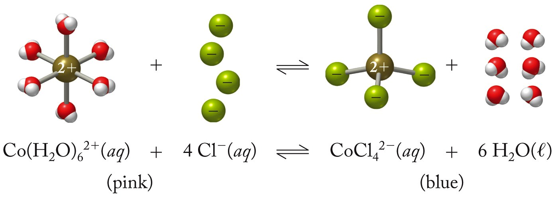
Coordinate Bonds
(Hydrated Ion)
(Ligands)
(Complex Ion)
All of these metal-ligand bonds are called coordinate bonds (or coordination bonds).
Notes:
Animation: add “coordinate bonds” and arrows

Slide 56
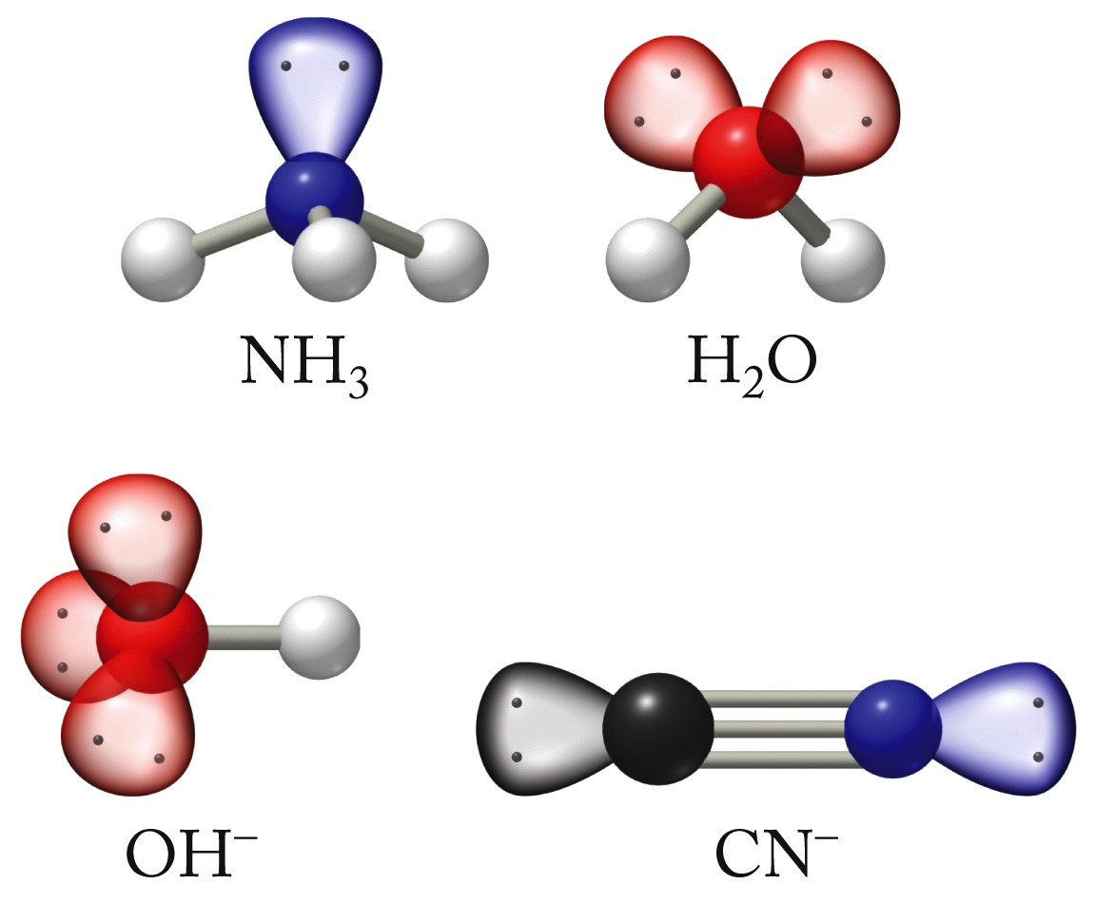
Common Ligands
Anions or molecules with lone pairs of electrons… aka Lewis bases:

Slide 57
More Complex-Ion Terminology
Counter Ions:
Ions that balance the electrical charges of complex ions in coordination compounds
Coordination Compound:
Any compound that contains a complex ion
Coordination Number:
Identifies the number of electron pairs surrounding a metal ion in a complex

Slide 58
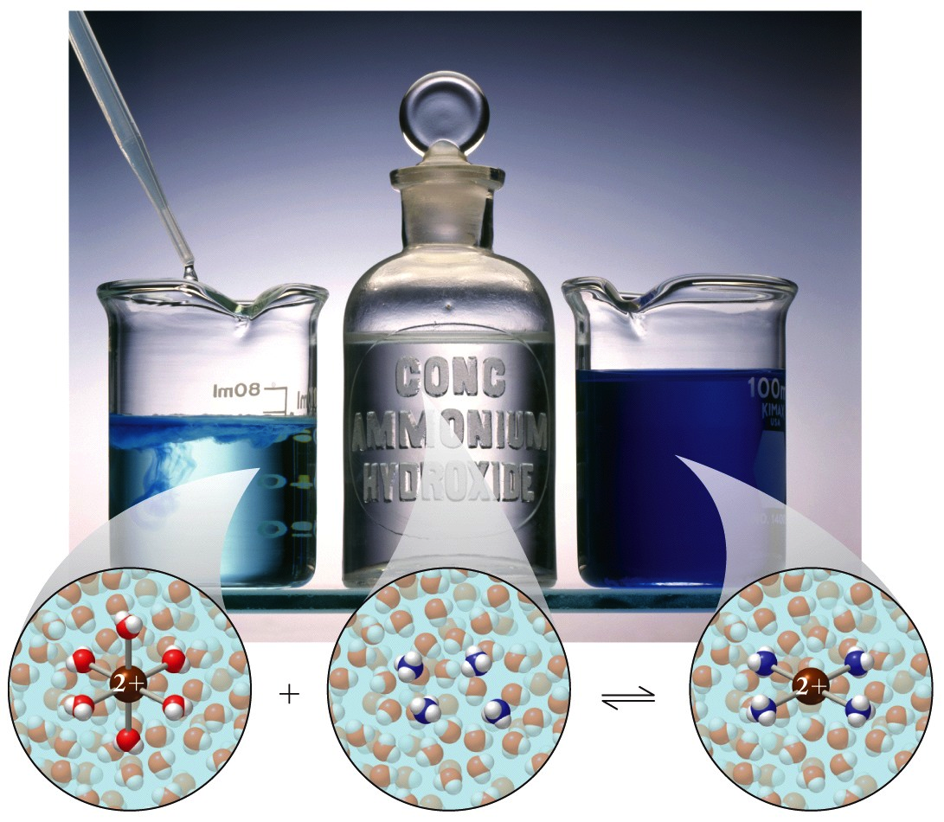
Complex-Ion Equilibria
Cu²⁺(aq) + 4NH₃(aq) ⇌ Cu(NH₃)₄²⁺(aq)
equilibrium of formation
As with all aqueous systems there is an equilibrium between reactants and products.
Cu²⁺(aq) often means Cu(H₂O)₆ ²⁺ (aq)

Slide 59
Example: Complex-Ion Equilibria
Calculate the equilibrium concentration of Zn²⁺(aq) in a solution that is initially 0.0125 M Zn(NO₃)₂ and 0.600 M NH₃.
Zn²⁺(aq) + 4 NH₃(aq) ⇌ Zn(NH₃)₄²⁺(aq) K_{f} = 2.9 ×10⁹
0.0125 moles 0.600 moles 0 moles
-0.0125 moles -4(0.0125) moles + 0.0125 moles
K_{f} is very large. Assume reaction goes to completion:
1) What runs out first?
2)How much of the other reactant is left
Be sure to account for coefficients.
3) Set up Equilibrium ICE table
 | [Zn²⁺] | [NH₃] | [Zn(NH₃)₄⁺]
Initial
Change
Equilibrium
0
0.550
0.0125
+x
+4x
-x
x
0.550 + 4x
0.0125 - x

Slide 60
Example: Complex-Ion Equilibria
Calculate the equilibrium concentration of Zn²⁺(aq) in a solution that is initially 0.0125 M Zn(NO₃)₂ and 0.600 M NH₃.
Zn²⁺(aq) + 4 NH₃(aq) ⇌ Zn(NH₃)₄²⁺(aq) K_{f} = 2.9 ×10⁹
Can write a K_{f} equilibrium expression
Set-up ICE table:
 | [Zn²⁺] | [NH₃] | [Zn(NH₃)₄⁺]
Initial
Change
Equilibrium
0
0.550
0.0125
To simplify the math, assume full complexation, then calculate the equilibrium back to left
+x
+4x
-x
x
0.550 + 4x
0.0125 - x
Substitute into expression:
Assume x << any of the initial concentrations because K is so large

Slide 61
What is the equilibrium concentration of Cu⁺(aq) in a solution that is initially 0.0200 M solution in CuNO₃(aq) and 0.450 M HCl(aq)?
Your Turn TopHat: Complex-Ion Equilibria
Cu⁺(aq) + 3 Cl⁻(aq) ⇌ CuCl₃²⁻(aq) K_{f} = 5.0 ×10⁵
5.0×10⁵ M
1.0×10⁻⁷ M
4.4×10⁻⁷ M
5.0×10⁻⁷ M
6.7×10⁻⁷ M

Slide 62
Chapter Outline
Ocean Acidification: Equilibrium Under Stress
The Common-Ion Effect
pH Buffers
Indicators and Acid-Base Titrations
Lewis Acids and Bases
Formation of Complex Ions
Hydrated Metal Ions as Acids
Solubility Equilibria

Slide 63
Video of following slides:
Hydrated Metal Ions and Acids

Slide 64
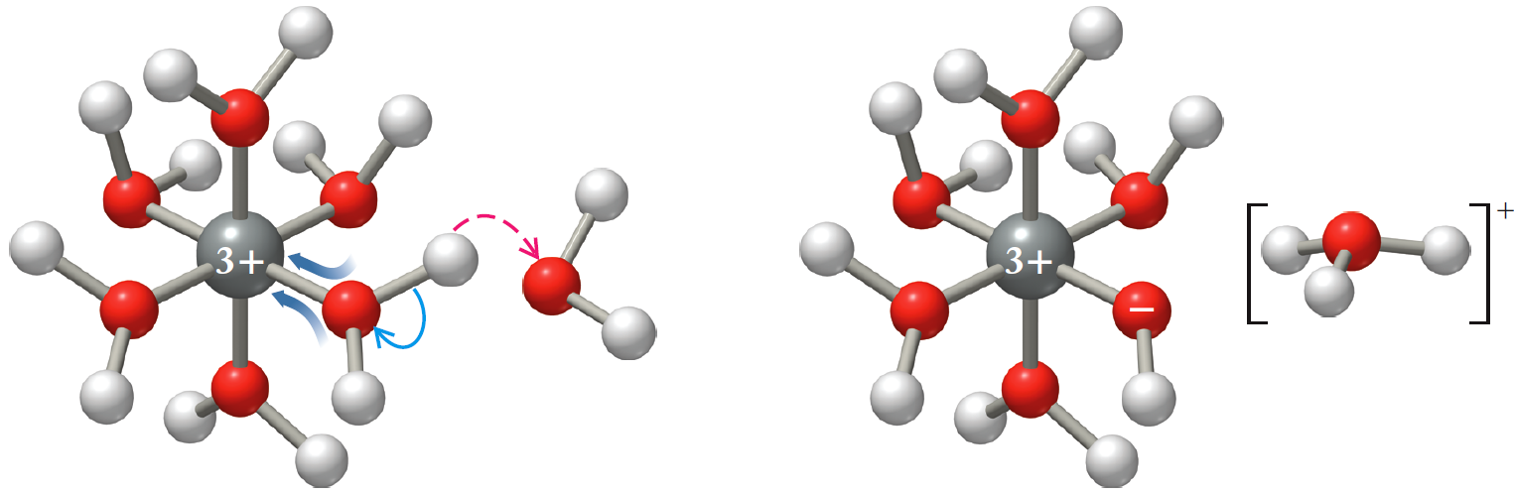
Hydrated Metal Ions as Acids
Aqua ligand ionizes, releasing H⁺ in solution
M(H₂O)₆^{n+}(aq) + H₂O(ℓ) ⇌ M(H₂O)₅(OH)^{n-1}(aq) + H₃O⁺(aq)
K_{a} = 3×10⁻³
Fe(H₂O)₆³⁺ + H₂O ⇌ Fe(H₂O)₅(OH)²⁺ + H₃O⁺
could be hydrated with a range of water molecules, often just simplified to the metal ion itself:
Fe³⁺(aq) + 2H₂O(l) ⇌ Fe(OH)²⁺(aq) + H₃O⁺(aq)

Slide 65
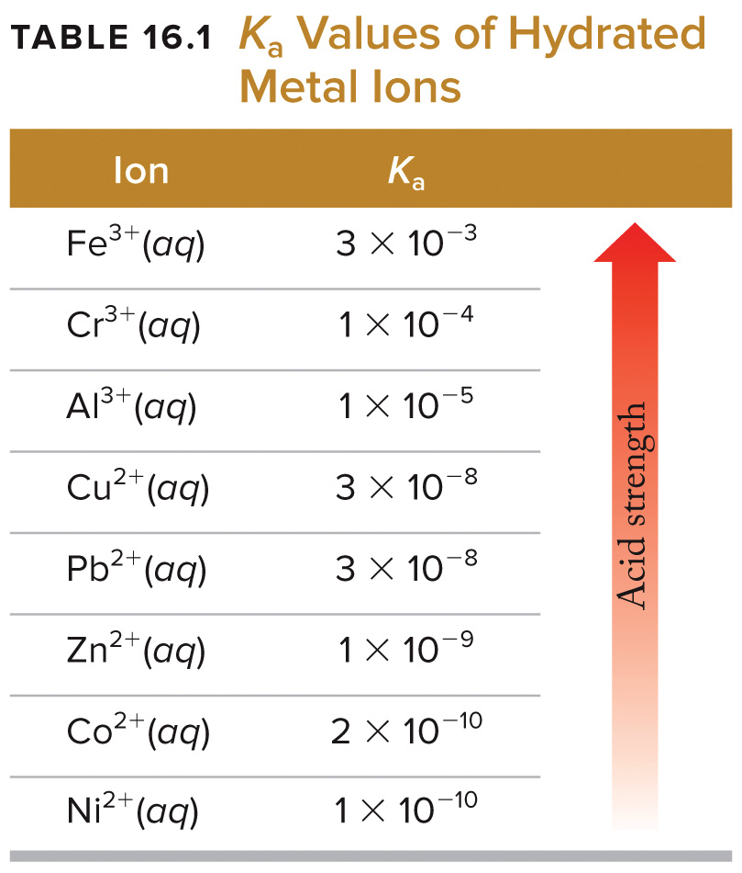
Hydrated Metal Ions as Acids
Note: Acid strength increases with cation charge.

Slide 66
Solubilities of Hydrated Complex Ions
Most transition metal cations form insoluble hydroxides:
Fe(OH)₃(s) ⇌ Fe³⁺(aq) + 3OH⁻(aq) K_{sp}= 1.1×10⁻³⁶
Al(OH)₃(s) ⇌ Al³⁺(aq) + 3OH⁻(aq) K_{sp} = 1.9×10⁻³³
For some, solubility increases in strongly basic solution:
Al(H₂O)₃(OH)₃(s)+ OH–(aq) ⇌ Al(H₂O)₂(OH)₄–(aq)

Slide 67
Example: Complex-Ion Equilibria (prelude)
16.89. What is the pH of a 0.100 M Fe(NO₃)₃ solution?
K_{a}=3x10^{–3}
At first we’d expect perhaps neutral: a) NO₃– is the conjugate of strong base
b) why would we expect Fe³⁺ to be acidic?
Hint: we are given a K_{a} and remember that Fe³⁺ would have water ligands.
Fe(NO₃)₃(s) → Fe³⁺(aq) + 3 NO₃⁻(aq)
Fe³⁺(aq) + 2H₂O(l) ⇌ Fe(OH)²⁺(aq) + H₃O⁺(aq)
Reminder on next slide
Notes:
Hidden combined on next slide for clarity

Slide 68
Example: Complex-Ion Equilibria (prelude)
16.89. What is the pH of a 0.100 M Fe(NO₃)₃ solution? K_{a}=3x10^{–3}
Fe(NO₃)₃(s) → Fe³⁺(aq) + 3 NO₃⁻(aq)
Fe³⁺(aq) + 2H₂O(l) ⇌ Fe(OH)²⁺(aq) + H₃O⁺(aq)
K_{a} = 3×10⁻³
Fe(H₂O)₆³⁺ + H₂O ⇌ Fe(H₂O)₅(OH)²⁺ + H₃O⁺
could be hydrated with a range of water molecules, often just simplified to the metal ion itself:
Fe³⁺(aq) + 2H₂O(l) ⇌ Fe(OH)²⁺(aq) + H₃O⁺(aq)

Slide 69
Example: Complex-Ion Equilibria
16.89. What is the pH of a 0.100 M Fe(NO₃)₃ solution? K_{a}=3x10^{–3}
Fe(NO₃)₃(s) → Fe³⁺(aq) + 3 NO₃⁻(aq)
Fe³⁺(aq) + 2H₂O(l) ⇌ Fe(OH)²⁺(aq) + H₃O⁺(aq)
 | [Fe³⁺] | [Fe(OH)²⁺] | [H₃O⁺]
Initial (M)
Change (M)
Equilibrium (M)
0.100
0
0
-x
+x
+x
0.100 - x
x
x
Use quadratic equation…
K_{a} is too big to make any assumptions about x

Slide 70
1210 Exp. 9 Discovery of Solubility Generalizations We experimented with a number of ionic compounds to com up with fundamental principles.
Basic easy rule:
Combinations where both ions are multiply charged are insoluble
Other ionic compounds are usually soluble
Some important exceptions:
Many sulfates are soluble even with multiply charged ions
Silver halides (and many silver compounds) are insoluble
Most hydroxides with multiply charged ions are insoluble
Explanation:
As we have seen, change in energy ∆E (or ∆H) plays a major role in determining if a process proceeds.
Here it is a combination of breaking the lattice—lattice energy and forming bonds with water—hydration energy.
See additional slides from Exp 9 on Pilot.

Slide 71
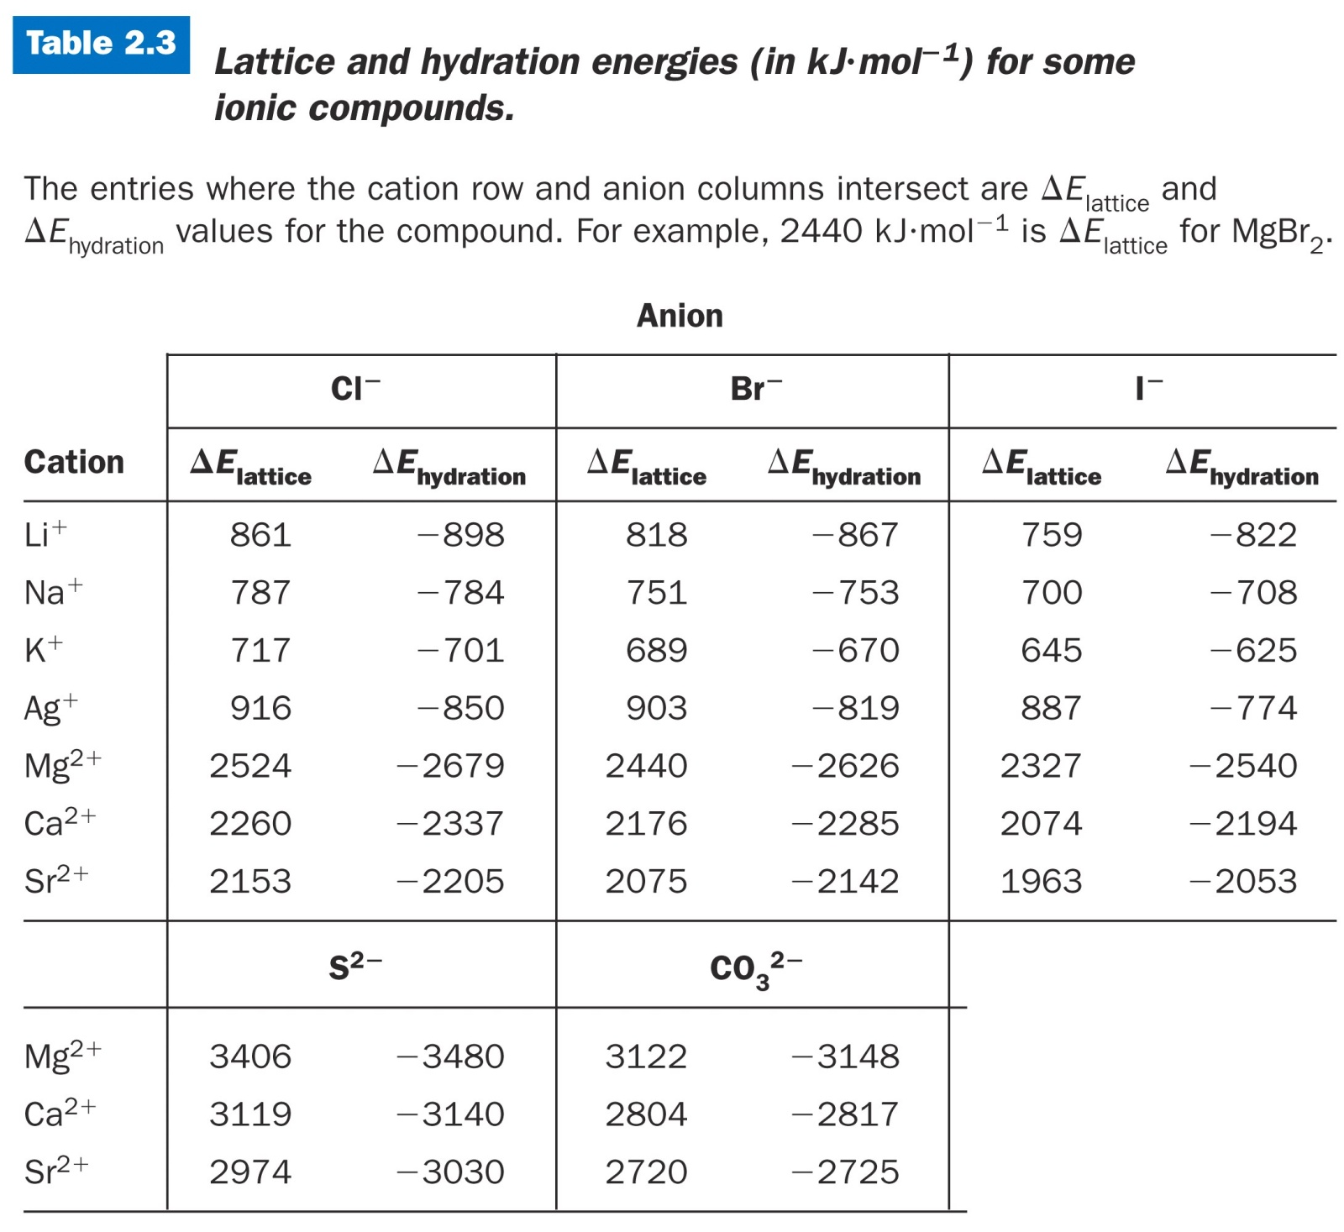
∆E>0 does not rule out solubility, just makes it less likely.
Notice NaCl is slightly positive.
+3 kJ/mol compared to AgCl 66 kJ/mol
This semester we will look at entropy effects.

Slide 72
Favorable and Unfavorable
Factors in Solutions of Ionic compounds
Energy
Energy is released
ΔE is negative
Energy is taken up
ΔE is positive
Entropy
Reorganization involved in mixing increases possible arrangements
Increased entropy
Reorganization of water around some solutes limits its freedom of motion
Larger charges are more strongly attracted to water thus constrain it more strongly and decreases possible arrangements
Decreased entropy
Balance of favorable and unfavorable factors determines solubility

Slide 73
Video of following slides:
Solubilty Equilibria
The following slides take the concepts of 1210 soluble or insoluble to calculations of equilibria to take into account slightly soluble, mostly insoluble, etc. to quantify it similar to other equilibria.
Using ICE tables and Le Chatelier’s principle

Slide 74
Solubility Equilibria
Solubility: Amount of solute that dissolves (g/L)
Molar Solubility (S): Amount of dissolved solute expressed as mol/L
Solubility Product Constant: K_{sp}
Mg(OH)₂(s) ⇌ Mg²⁺(aq) + 2OH⁻(aq)
Note: This really only needs to be worried about if dealing with an ionic compound with only partial solubility in water (or near saturation conditions for extremely soluble ones).

Slide 75
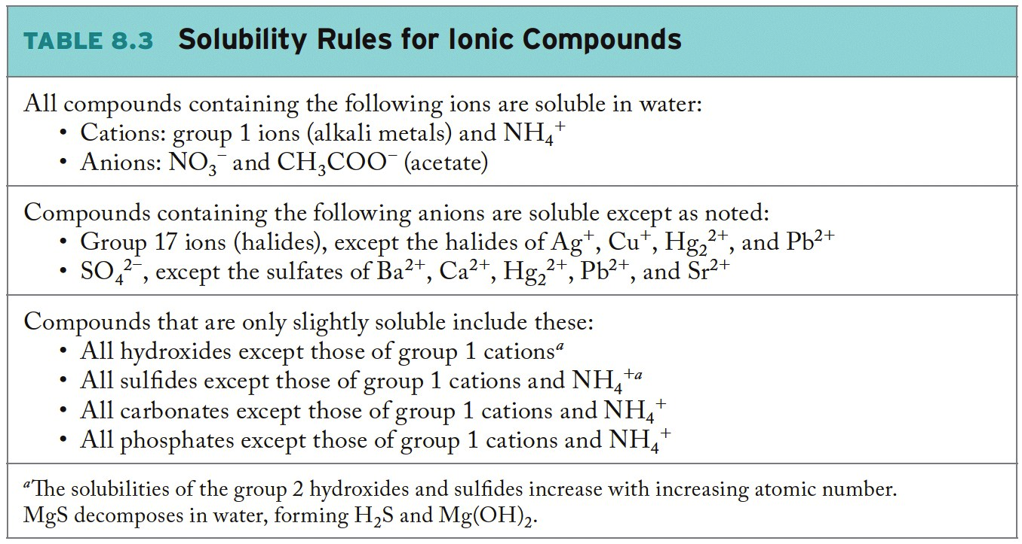
Review: Solubility Rules
(Chapter 8, p. 326)

Slide 76
K_{sp} v. Q: Will a Precipitate Form?
As with all these other equilibria, can write a reaction quotient for reactions at any point in time:
Mg(OH)₂(s) ⇌ Mg²⁺(aq) + 2OH⁻(aq)
If Q < K_{sp}, the solution is not saturated and a precipitate will not form
If Q > K_{sp}, the solution is beyond point of saturation and a precipitate will form to achieve equilibrium ion concentration
If Q = K_{sp}, the solution is perfectly saturated
K_{sp} values for partially soluble ionic compounds can be found in Appendix 5.

Slide 77
Calculating Molar Solubility (S)
Molar solubility calculated by solving equilibrium problem:
Mg(OH)₂(s) ⇌ Mg²⁺(aq) + 2OH⁻(aq)
Ex.
Concentration dissolved:
(x)
(x)
(2x)
Often solubility is given in g/L or g/mL…be prepared to convert if necessary.
(x = S, molar solubility)
mol Mg(OH)₂ per L of water
Note that this is fairly small and Mg(OH)₂ in considered slightly or insoluble
Notes:
Mg(OH)2 being low solubility is why it is not a strong base like the other alkaline earths.

Slide 78
Factors Affecting Solubility
Common-Ion Effect:
BaSO₄(s) ⇌ Ba²⁺(aq) + SO₄²⁻(aq)
Na₂SO₄(s) → 2Na⁺(aq) + SO₄²⁻(aq)
K_{sp} = [Ba²⁺][SO₄²⁻]
Add sodium sulfate to the solution:
Presence of “common ion” (SO₄²⁻) will shift BaSO₄ equilibrium to the left, decreasing solubility.
BaSO₄(s) ⇌ Ba²⁺(aq) + SO₄²⁻(aq)
adding SO₄²⁻
= reaction driven to left, decreasing solubility (causing precipitation)

Slide 79
Factors Affecting Solubility
pH:
For insoluble salts containing basic anions, solubility increases as pH decreases:
CaF₂(s) ⇌ Ca²⁺(aq) + 2F⁻(aq)
F⁻(aq) + H⁺(aq) ⇌ HF(aq)
K_{sp} = [Ca²⁺][F⁻]²
Add acid (H⁺) to the solution:
Fluoride anions are consumed.
Application of Le Châtelier’s Principle:
CaF₂(s) ⇌ Ca²⁺(aq) + 2F⁻(aq)
removing F⁻
= equilibrium shifts right, solubility of CaF₂ increases (more ionization = more dissolution)

Slide 80
Example: Molar Solubility
Calculate the molar solubility of Mg(OH)₂ in a solution of 0.050 M MgCl₂.
(K_{sp} for Mg(OH)₂ = 5.6×10⁻¹²)
MgCl₂(s) → Mg²⁺(aq) + 2Cl⁻(aq)
Dissolution equation:
common-ion effect
Mg(OH)₂(s) ⇌ Mg²⁺(aq) + 2OH⁻(aq)
Concentration dissolved:
(x)
(0.05 + x)
(2x)
K_{sp} expression:
Substitute equilibrium quantities
Because K_{sp} is so small: assume that x << 0.05 M
mol Mg(OH)₂ per L of 0.05 M MgCl₂
Notice: less soluble than in pure water due to common-ion effect!

Slide 81
The solubility of PbBr₂ is 0.427 g per 100.0 mL of solution at 25°C. Determine the value of the solubility product constant for this strong electrolyte. Lead(II) bromide does not react with water.
TopHat: K_{sp} Calculations
5.4×10⁻⁴
2.7×10⁻⁴
3.1×10⁻⁶
1.6×10⁻⁶
6.3×10⁻⁶

